Slide 1
Housing Market Explorer
DEPI Graduation project

Slide 2
Our Team
Islam Abdeljawaad
Mohamed Adel
Ahmed Abdelbaset
Habiba Kandil
Rana Ashraf
Under Supervision: Eng. Mahmoud Elsayed

Slide 3
01
TABLE OF CONTENTS
02
03
04
Introduction
Dashboards

Slide 4

01
Introduction

Slide 5
Introduction
Real estate in Egypt suffers from inconsistent pricing and lack of transparent valuation. The project’s goal is to build a predictive model to estimate property prices using machine learning. This helps buyers, sellers, developers, and financial institutions make informed decisions.
Dataset shows real estate listings scraped from popular Egyptian property platforms.
Key Attributes:
- Price - Numerical (Continuous)
- Bedrooms - Numerical (Discrete)
- Bathrooms – Numerical (Discrete)
- Furnished (Yes/No): Categorical (Binary)
- City: Categorical (Nominal).
- Compound: Categorical (Nominal).
- Payment Option (e.g., Cash): Categorical (Nominal).

Slide 6
This script performs comprehensive data cleaning and preprocessing on a real estate dataset. The key steps , include handling duplicates, standardizing categories, converting data types, handling missing values, detecting , and removing outliers.
Handling Duplicates:
- The dataset is copied to avoid modifying the original data.
- Duplicate rows are removed using drop_duplicates().
Standardizing Property Types:
- The Type column contains variations in capitalization for the same property type
(e.g.,"twin house"and "Twin House").
- The values are standardized to maintain consistency.
Cleaning the "Price" Column:
- The script identifies non-numeric values in the Price column, such as "Unknown".
- Rows with "Unknown" prices are removed.
- The Price column is converted to a numeric format.

Slide 7
Cleaning the "Bedrooms" Column:
- A unique value check reveals an entry "10+".
- The value "10+" is replaced with 10.
- The column is converted to a numeric type.
Cleaning the "Bathrooms" Column:
- A unique value check reveals an entry "10+".
- The value "10+" is replaced with 10.
- The column is converted to a numeric type.
Enforcing Logical Ranges for Bedrooms & Bathrooms
- Each property type is assigned a valid range for bedrooms and bathrooms.
- Values slightly outside the range (within 10%) are adjusted.
- Extreme outliers are dropped from the dataset.

Slide 8
Cleaning the "Area" Column
- The script ensures that all values in the Area column are numeric.
- The column is converted to float.
Enforcing Logical Ranges for Area
- Each property type is assigned a valid area range.
- Values slightly outside the range (within 10%) are adjusted.
- Extreme outliers are dropped.

Slide 9
21,000
175
539
Total property
Count of cities
Count of compounds

Slide 10
Feature Engineering Overview
Creating Price Categories Based on City & Type
Creating Price Categories Based on Absolute Price Ranges
Categorizing Area Based on Percentiles
Converting Delivery Date to Numeric Values
Creating New Features
Feature Interactions
Scaling Numerical Features
Encoding Categorical Features

Slide 11
Predictive Modeling
Models Used:
Linear Regression: Baseline model for price prediction.
Random Forest Regressor: Improved accuracy with feature importance analysis.
Gradient Boosting (XGBoost): Best-performing model for price prediction.
Model Evaluation Metrics
Root Mean Square Error (RMSE) to measure prediction accuracy.
R-squared value to determine model fit.

Slide 12
02
Dashboards

Slide 13
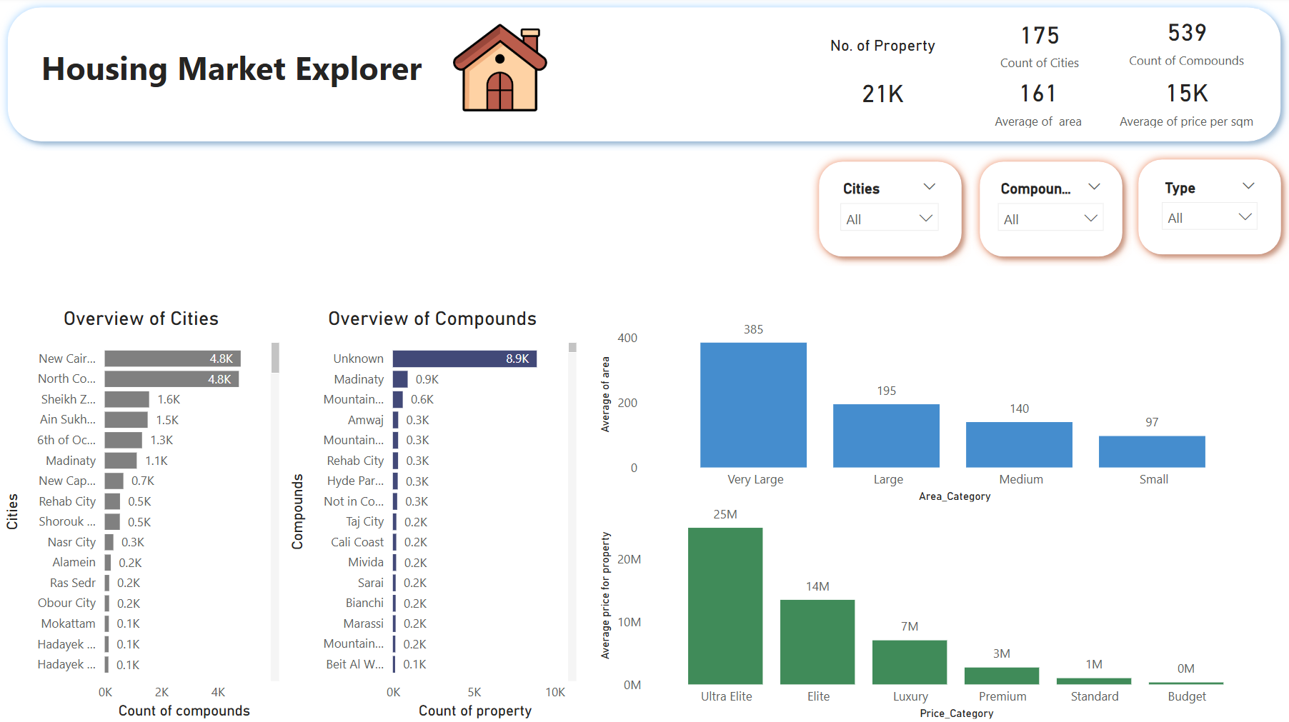

Slide 14
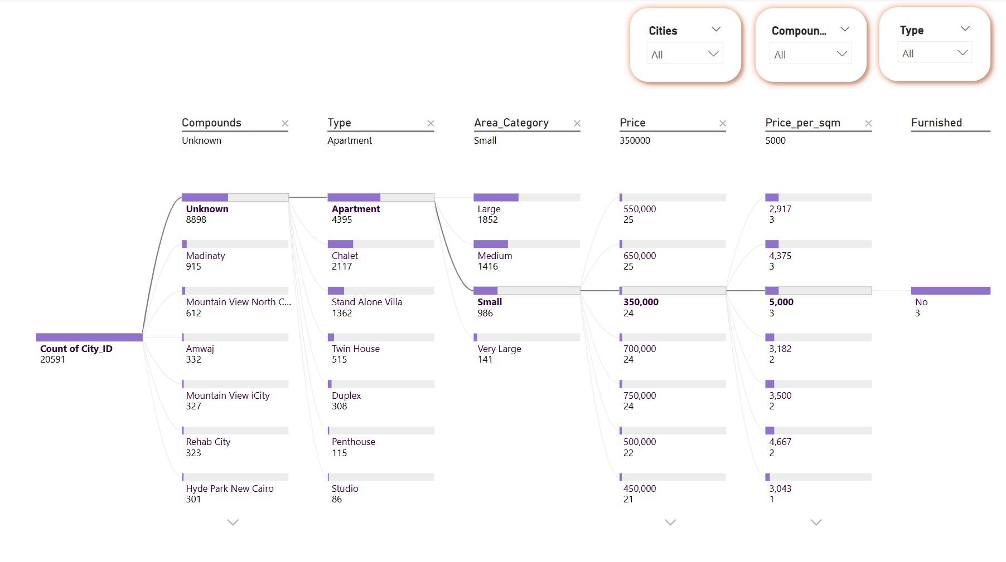

Slide 15
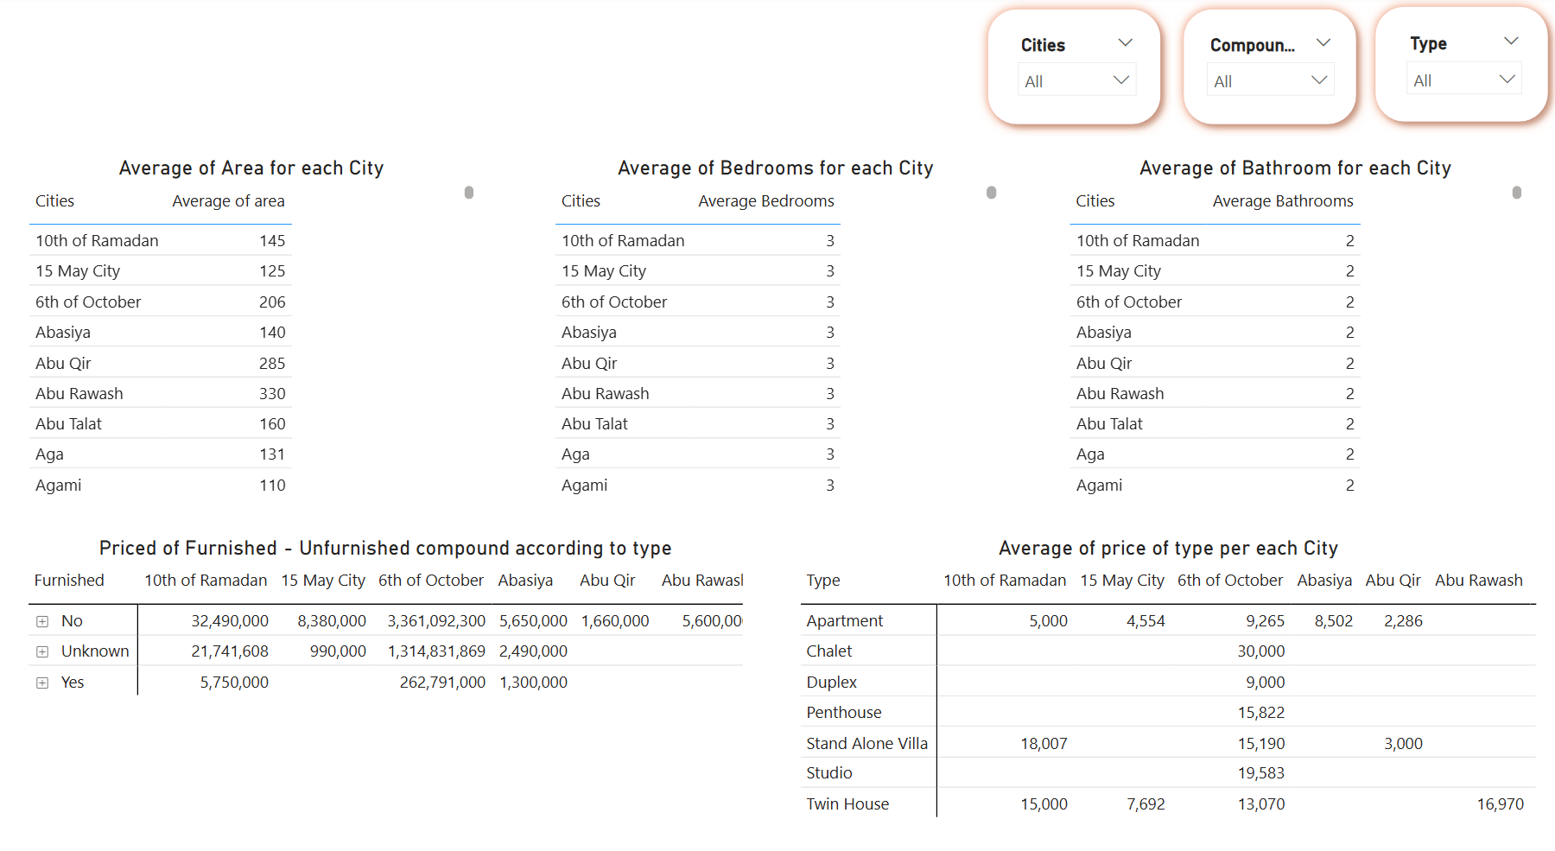

Slide 16
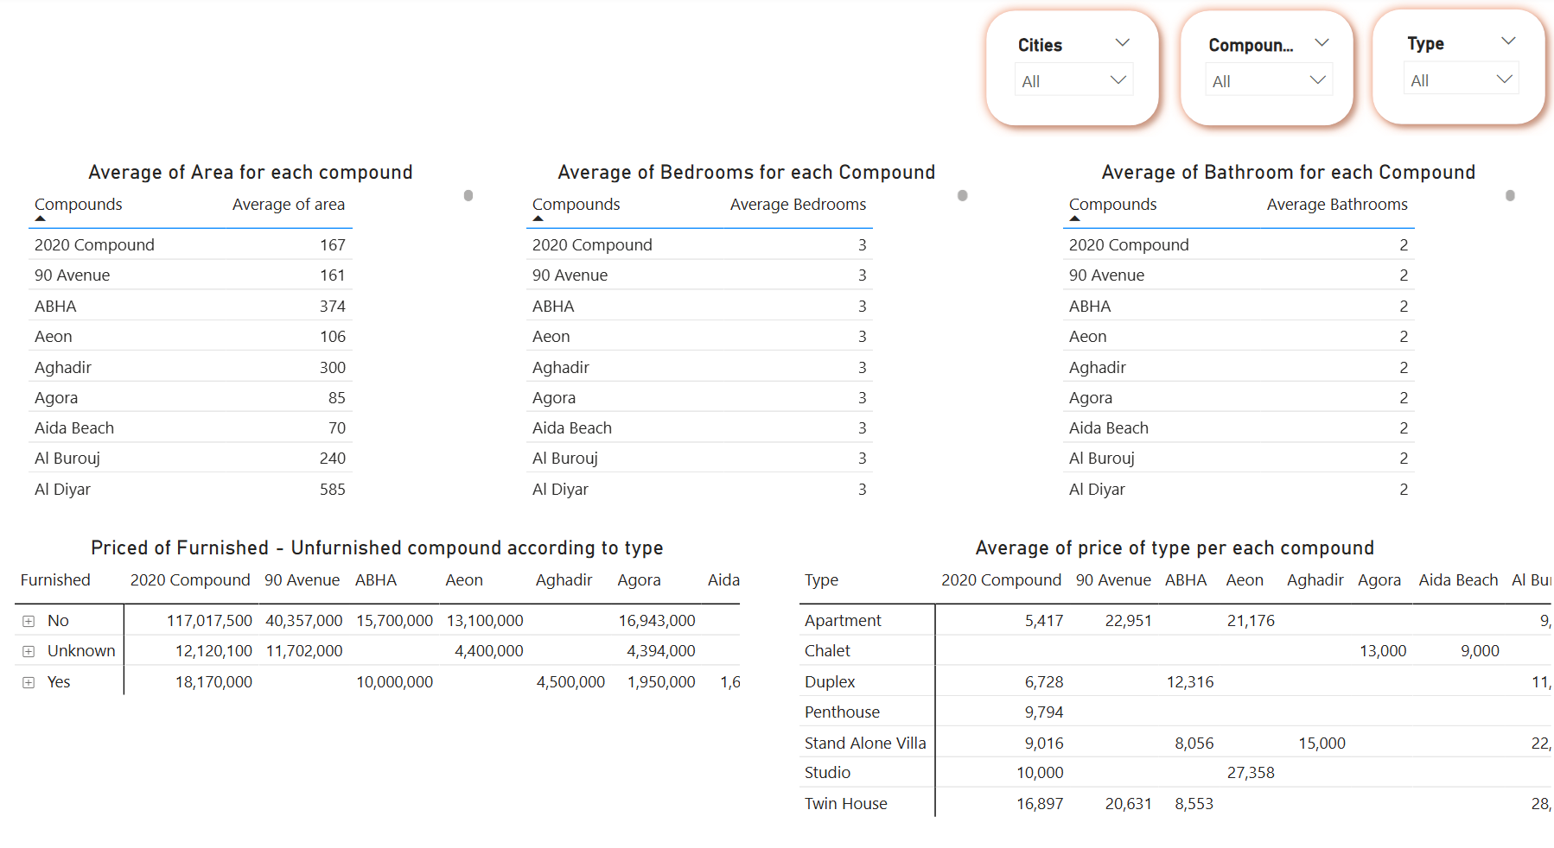

Slide 17
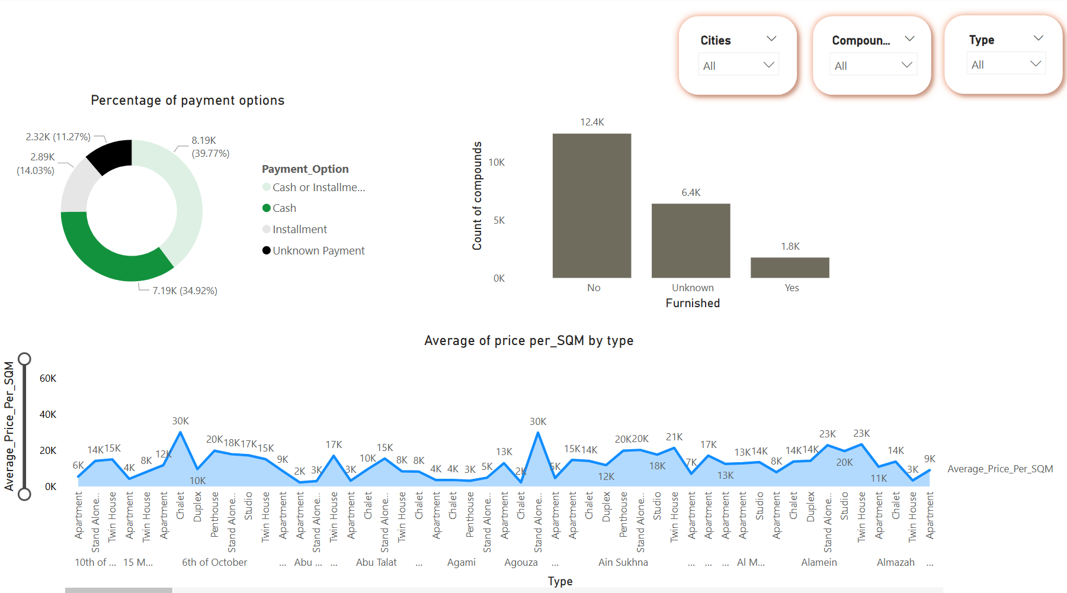

Slide 18
Use our editable graphic resources...
You can easily resize these resources without losing quality. To change the color, just ungroup the resource and click on the object you want to change. Then, click on the paint bucket and select the color you want. Group the resource again when you’re done. You can also look for more infographics on Slidesgo.

